Slide 1
Thermal Considerations in a Pipe Flow
Thermal conditions
  Laminar or turbulent
  entrance flow and fully developed thermal condition
Thermal entrance region, x_{fd,t}
For laminar flows the thermal entrance length is a function of the Reynolds number and the Prandtle number: x_{fd,t}/D ≈ 0.05Re_{D}Pr, where the Prandtl number is defined as Pr = ν/α and α is the thermal diffusitivity.
For turbulent flow, x_{fd,t} ≈ 10D.

Slide 2
Thermal Conditions
For a fully developed pipe flow, the convection coefficient is a constant and is not varied along the pipe length. (as long as all thermal and flow properties are constant also.)
h(x)
constant
x
x_{fd,t}
Newton’s law of cooling: q”_{S} = hA(T_{S}-T_{m})
Question: since the temperature inside a pipe flow is not constant, what temperature we should use. A mean temperature T_{m} is defined.

Slide 3
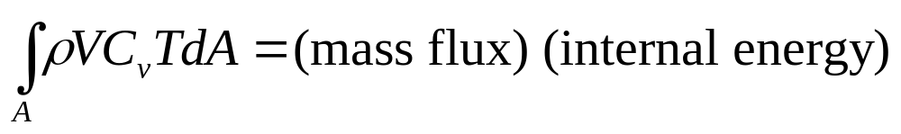
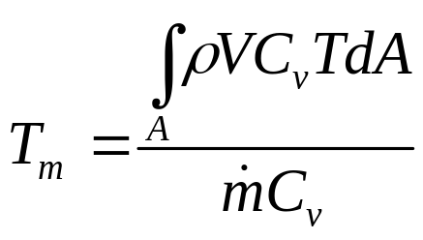
Energy Transfer
Consider the total thermal energy carried by the fluid as
Now image this same amount of energy is carried by a body of fluid with the same mass flow rate but at a uniform mean temperature T_{m}. Therefore T_{m} can be defined as
Consider T_{m} as the reference temperature of the fluid so that the total heat transfer between the pipe and the fluid is governed by the Newton’s cooling law as: q_{s}”=h(T_{s}-T_{m}), where h is the local convection coefficient, and T_{s} is the local surface temperature. Note: usually T_{m} is not a constant and it varies along the pipe depending on the condition of the heat transfer.

Slide 4
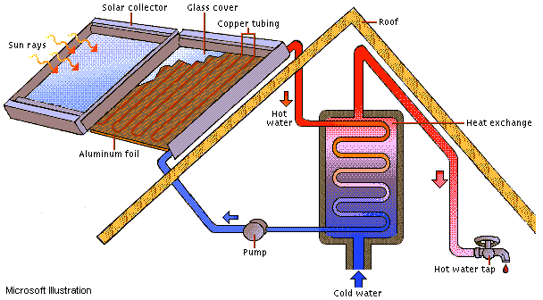
Energy Balance
Example: We would like to design a solar water heater that can heat up the water temperature from 20° C to 50° C at a water flow rate of 0.15 kg/s. The water is flowing through a 5 cm diameter pipe and is receiving a net solar radiation flux of 200 W per unit length (meter). Determine the total pipe length required to achieve the goal.

Slide 5
Example (cont.)
Questions: (1) How do we determine the heat transfer coefficient, h?
There are a total of six parameters involving in this problem: h, V, D, ν, k_{f}, c_{p}. The last two variables are thermal conductivity and the specific heat of the water. The temperature dependence is implicit and is only through the variation of thermal properties. Density ρ is included in the kinematic viscosity, ν=μ/ρ. According to the Buckingham theorem, it is possible for us to reduce the number of parameters by three. Therefore, the convection coefficient relationship can be reduced to a function of only three variables:
Nu=hD/k_{f}, Nusselt number, Re=VD/ν, Reynolds number, and
Pr=ν/α, Prandtle number.
This conclusion is consistent with empirical observation, that is
Nu=f(Re, Pr). If we can determine the Reynolds and the Prandtle numbers, we can find the Nusselt number, hence, the heat transfer coefficient, h.

Slide 6
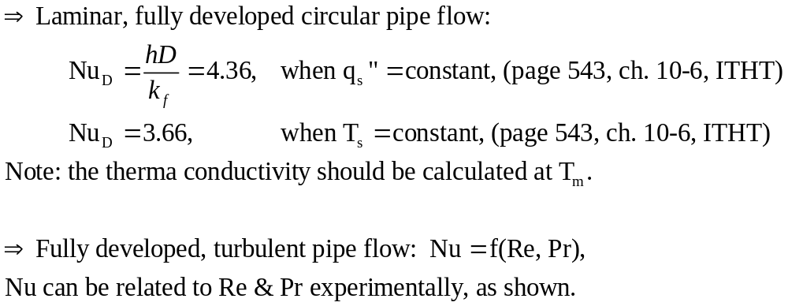
Convection Correlations
Fixed Pr
Fixed Re
ln(Nu)
ln(Nu)
slope m
slope n
ln(Re)
ln(Pr)

Slide 7
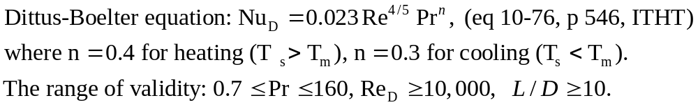
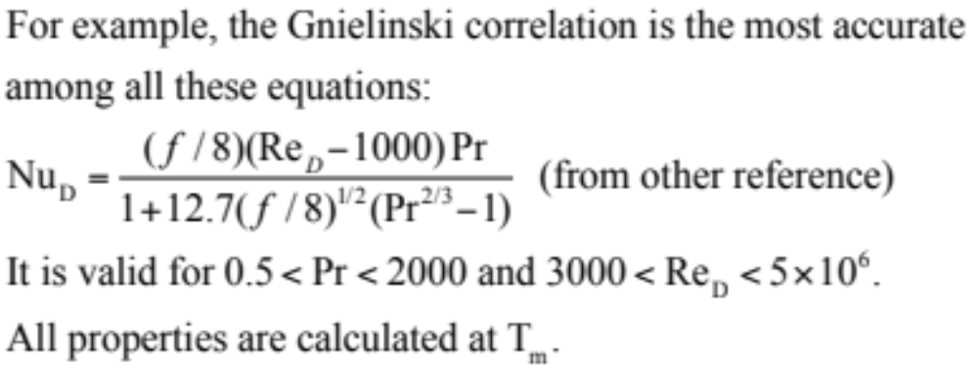
Empirical Correlations
Note: This equation can be used only for moderate temperature difference with all the properties evaluated at T_{m}.
Other more accurate correlation equations can be found in other references.
Caution: The ranges of application for these correlations can be quite different.

Slide 8
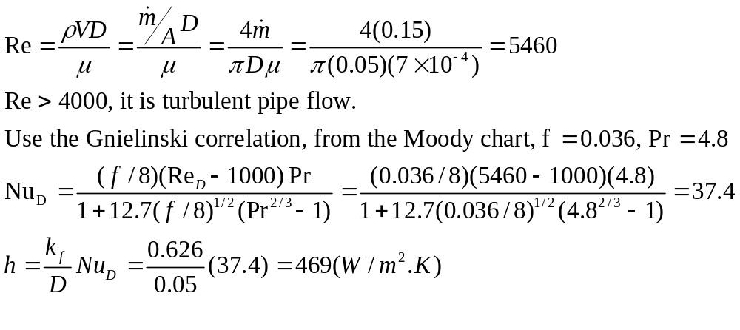
Example (cont.)
In our example, we need to first calculate the Reynolds number: water at 35°C, Cp=4.18(kJ/kg.K), μ=7x10⁻⁴ (N.s/m²), k_{f}=0.626 (W/m.K), Pr=4.8.

Slide 9
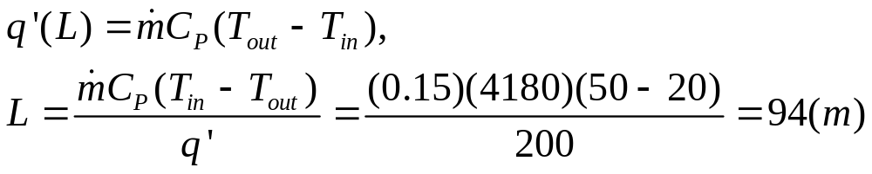
Energy Balance
Question (2): How can we determine the required pipe length?
Use energy balance concept: (energy storage) = (energy in) minus (energy out). energy in = energy received during a steady state operation (assume no loss)
q’=q/L
T_{in}
T_{out}

Slide 10
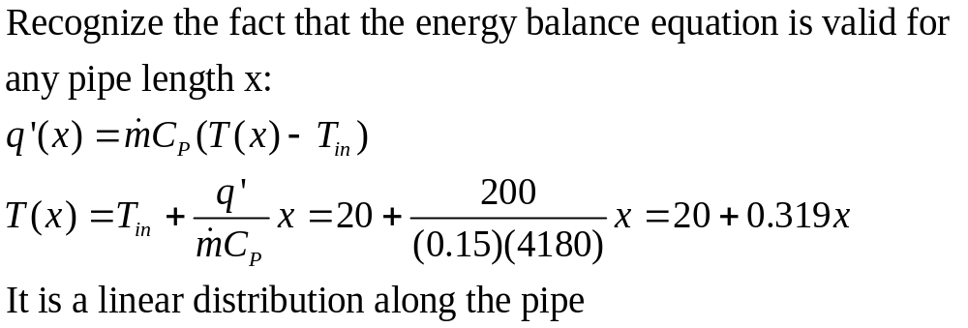
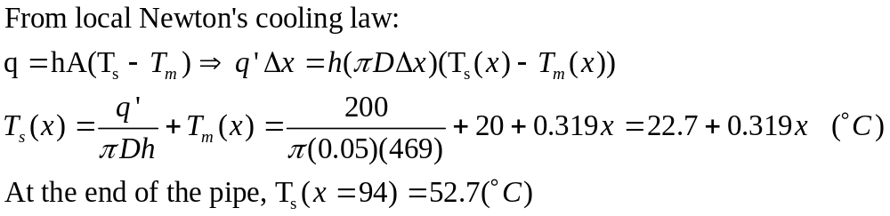
Temperature Distribution
Question (3): Can we determine the water temperature variation along the pipe?
Question (4): How about the surface temperature distribution?

Slide 11
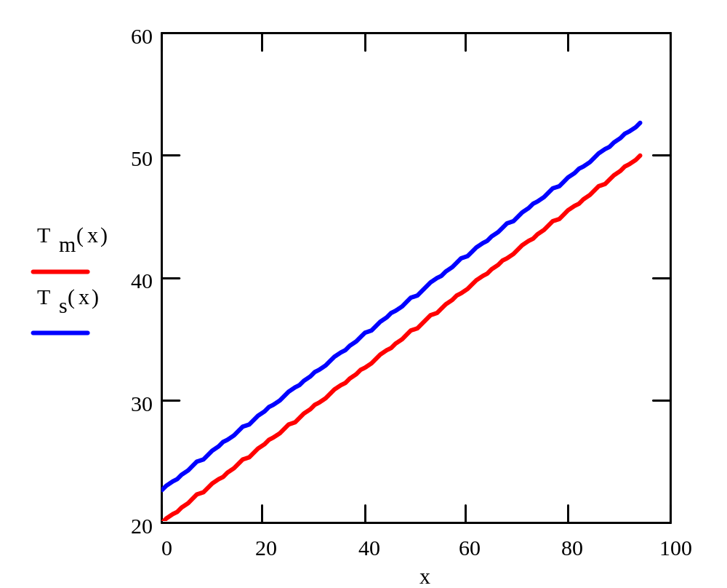
Temperature variation for constant heat flux
Constant temperature
difference due to the constant heat flux.
Note: These distributions are valid only in the fully developed region. In the entrance region, the convection condition should be different. In general, the entrance length x/D≈10 for a turbulent pipe flow and is usually negligible as compared to the total pipe length.

